Slide 1
BIA 652:
Predicting Employee Churn
Shivansh Wadhwani, Ishan Trikha, Abishek Rao, Thoai Phan

Slide 2

Objectives
Employee churn is a major problem for many companies these days
Employee churn has many bad effects on the company: decreased performance, decreased knowledge base, increased cost, etc.
Predictive analytics can be a strategic tool to manage workforce effectively and set up well targeted employee retention plans
The goal of this project is to build a predictive model that helps identifying employees who are at high risk of leaving the company
Notes:
Abishek

Slide 3
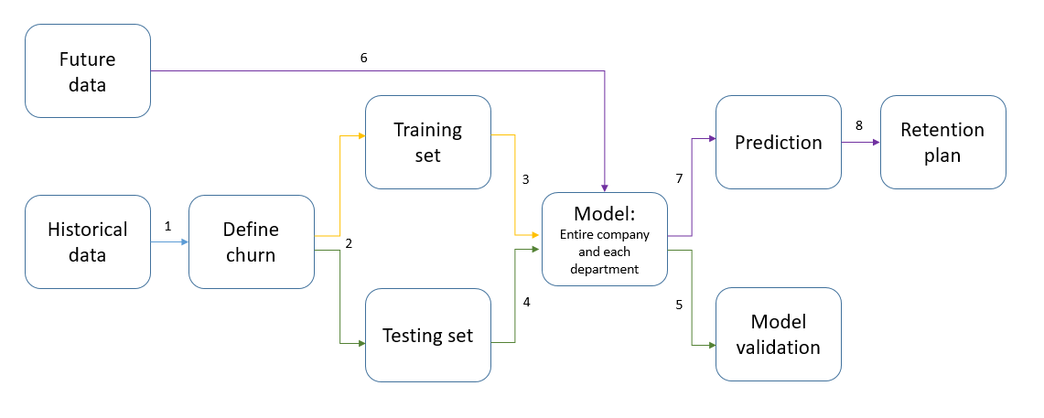
Methodology
Notes:
Abishek
Abishek

Slide 4
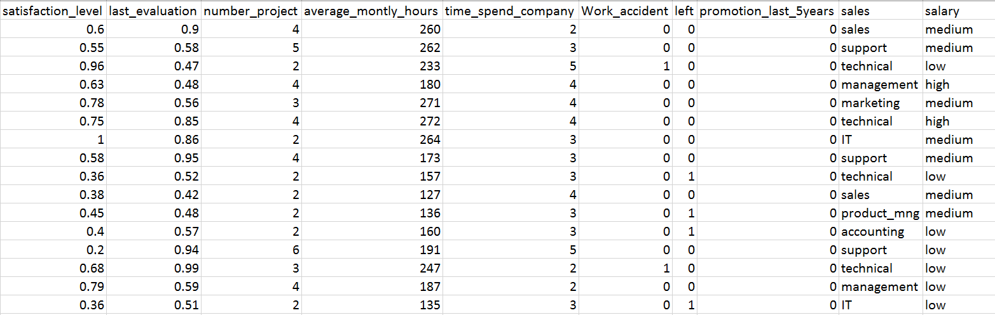
Dataset
Kaggle dataset
Total: 14,999 records, 10 attributes
Training set: 11,999 records. Testing set: 3,000 records
Notes:
Abishek

Slide 5
Attribute Description
Employee satisfaction level
Employee’s last evaluation
Number of projects the employee has worked on
Average monthly hours
Time spent at the company (in years)
Whether the employee has had a work accident within the past 2 years
Whether the employee has had a promotion in the last 5 years
Department
Salary (low, medium, high)
Whether the employee has left
Notes:
Abishek

Slide 6
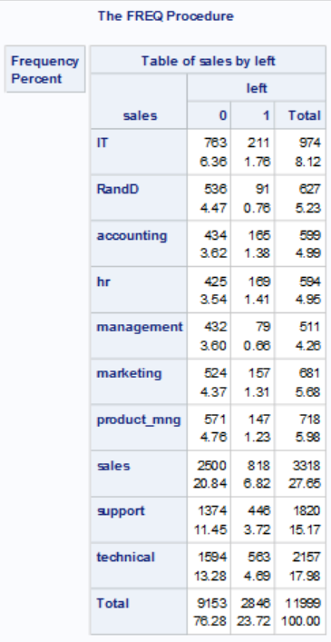
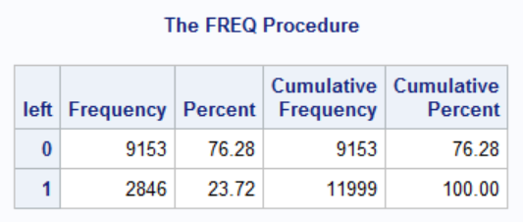
Descriptive Statistics
Notes:
Shivansh
Different churn rate for each department -> build different models for each department

Slide 7
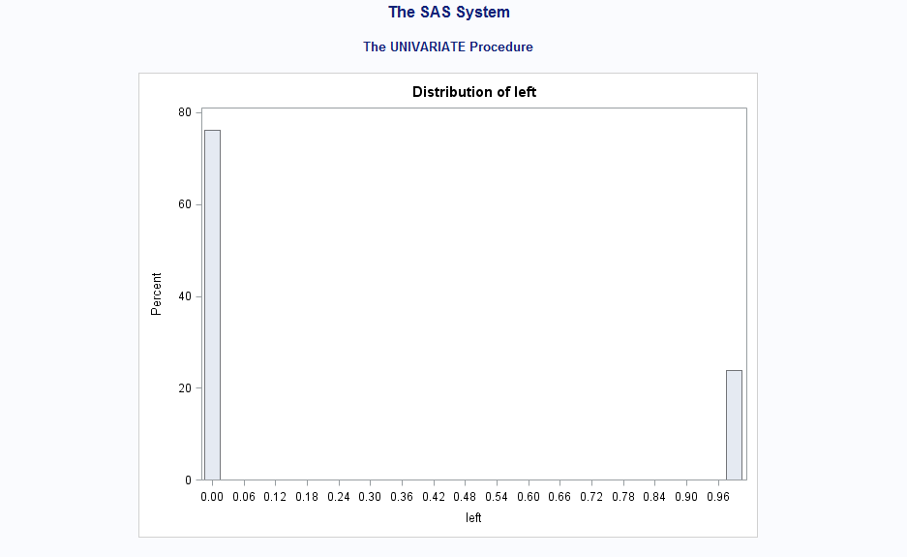
Notes:
shivansh

Slide 8
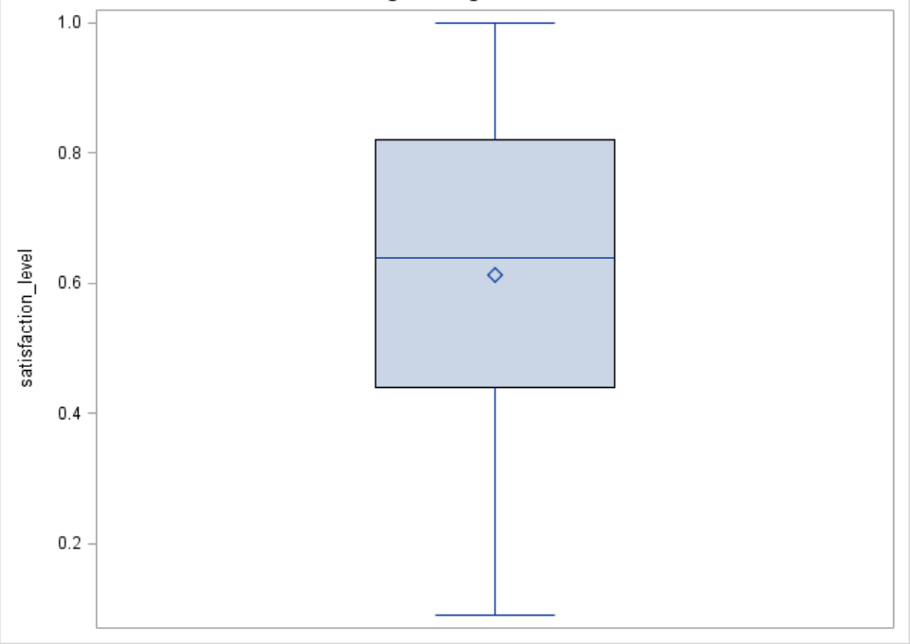
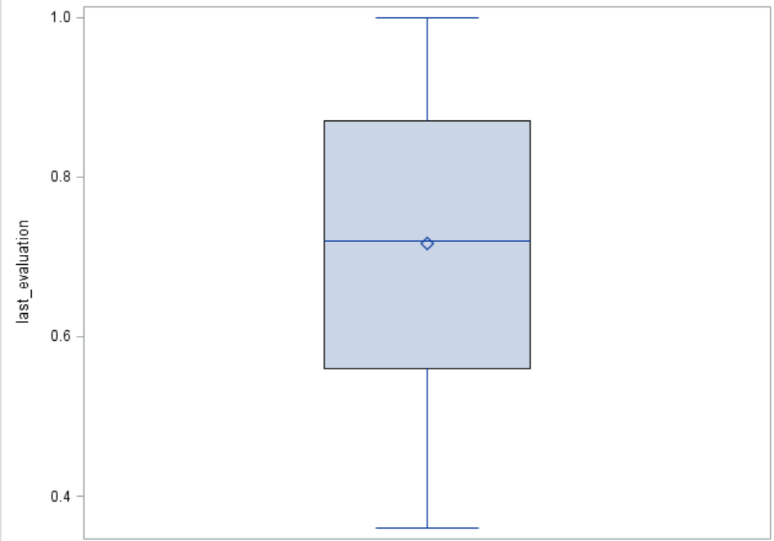
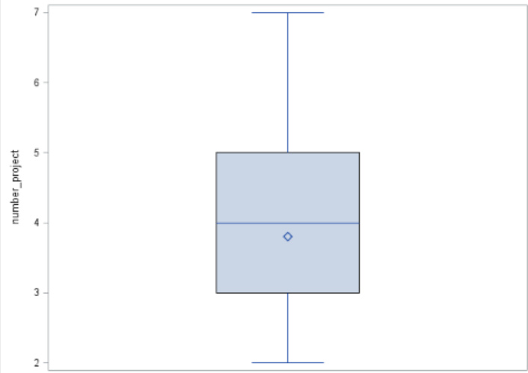
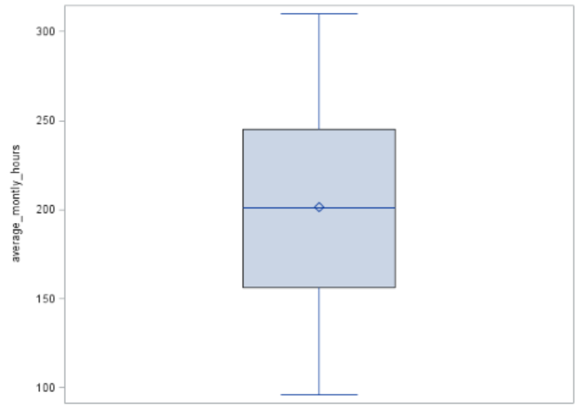
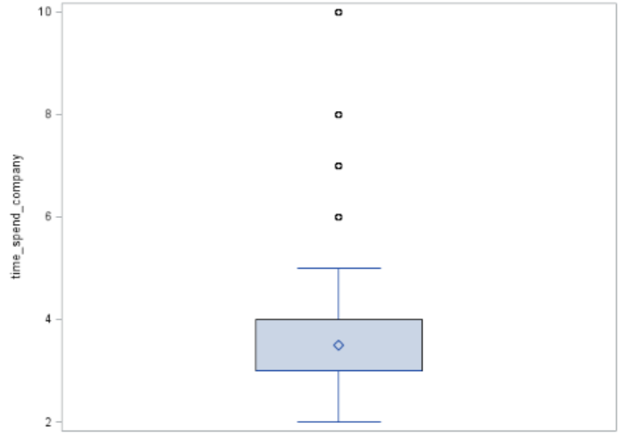
Descriptive Statistics
Outliers
Notes:
Shivansh

Slide 9
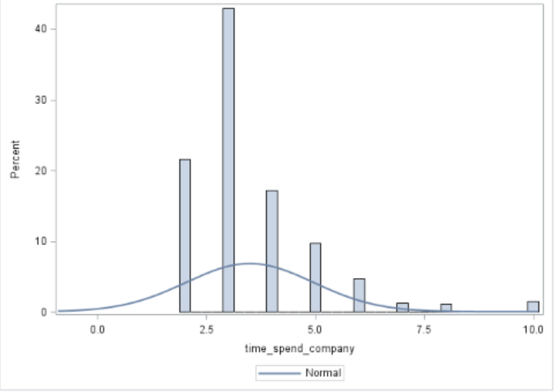
Descriptive Statistics
Histogram of time_spend_company to check normal distribution

Slide 10
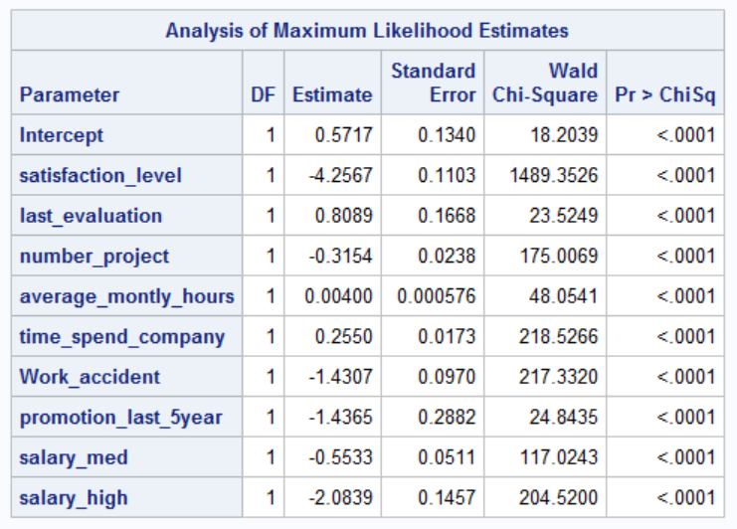
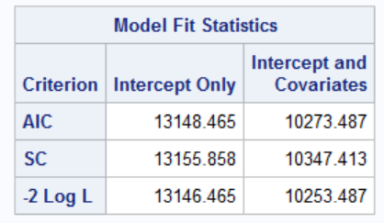
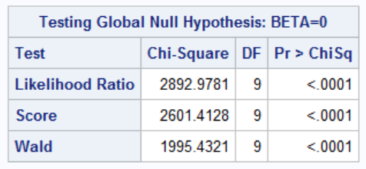
Logistic Regression: All Variables
Notes:
Shivansh

Slide 11
Regression Equation
Logit (p of left) = 0.57-4.25*satisfaction_level+0.81*last_evaluation
-0.32*number_project+0.004*average_monthly_hours+0.26*time_spend_company
-1.43*work_accident-1.44*promotion_last_5years-0.55*salary_medium-2.08*salary_high
Notes:
Shivansh

Slide 12
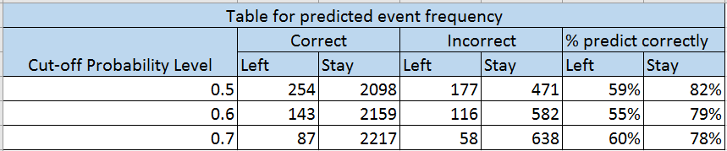
Equation Validation
Calculate the probability of each records in testing set in Excel using the regression function
Compare predicted and actual results using different cut-off probability level to find out the cut-off level that gives the best prediction accuracy
Notes:
Thoai

Slide 13
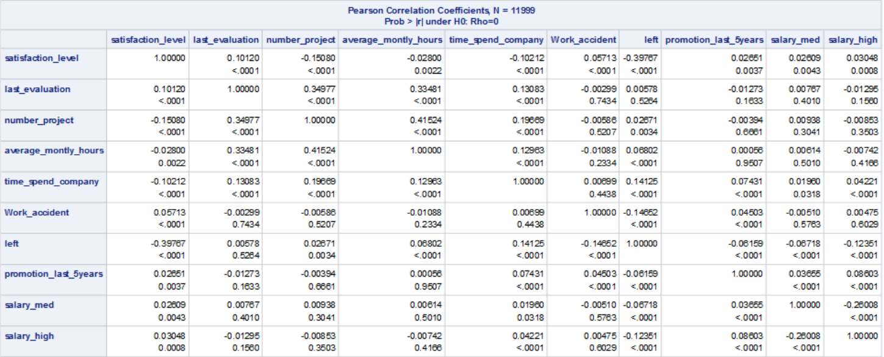
Correlation Analysis
Average_monthly_hours and last_evaluation and number_project are highly correlated, so we removed last_evaluation and number_project to improve the model
Notes:
Thoai

Slide 14
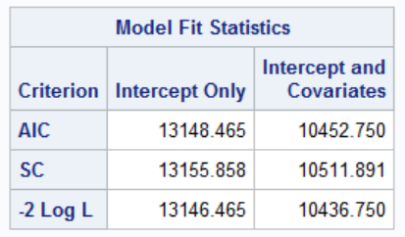
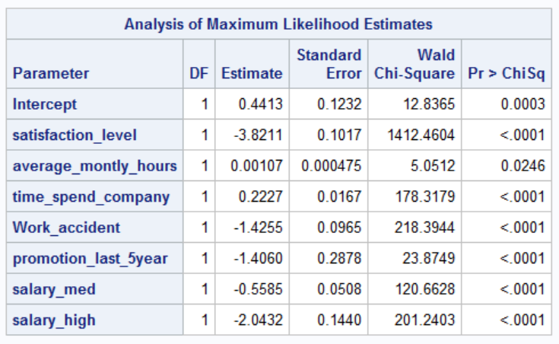

Logistic Regression: Selected Variables
Notes:
Thoai

Slide 15
Regression Equation
Logit (p of left) = 0.44-3.83*satisfaction_level+0.001*average_monthly_hours
+0.22*time_spend_company-1.42*work_accident-1.40*promotion_last_5years
-0.55*salary_medium-2.04*salary_high
Notes:
Thoai

Slide 16
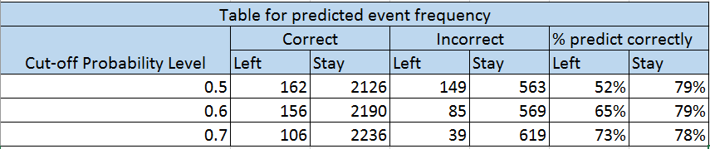
Equation Validation
Prediction accuracy increased from 60% to 73% with the new equation
The model has good predictive ability
Notes:
Thoai

Slide 17
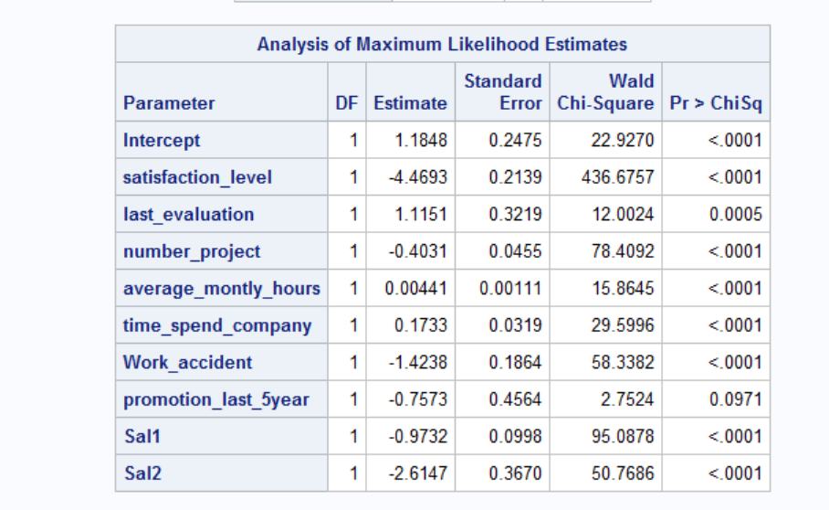
Logistic Regression by Sales Department
Notes:
Ishan

Slide 18
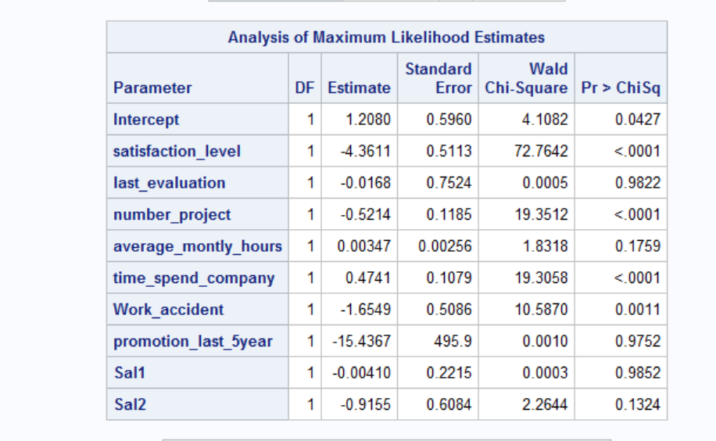
Logistic Regression by HR Department
Notes:
Ishan

Slide 19
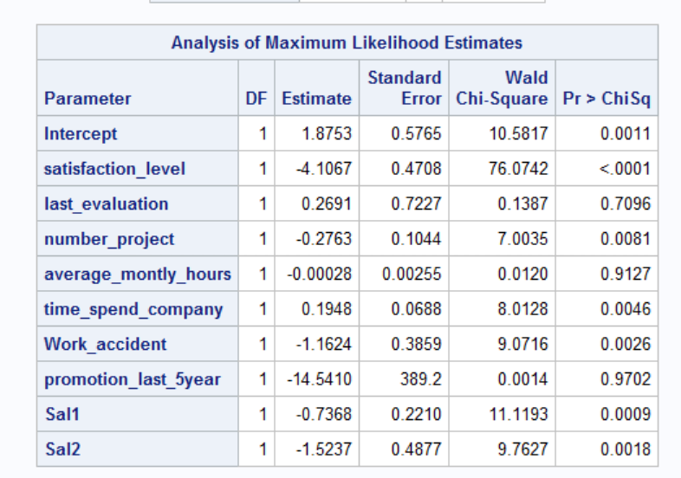
Logistic Regression by Marketing Department
Notes:
Ishan

Slide 20
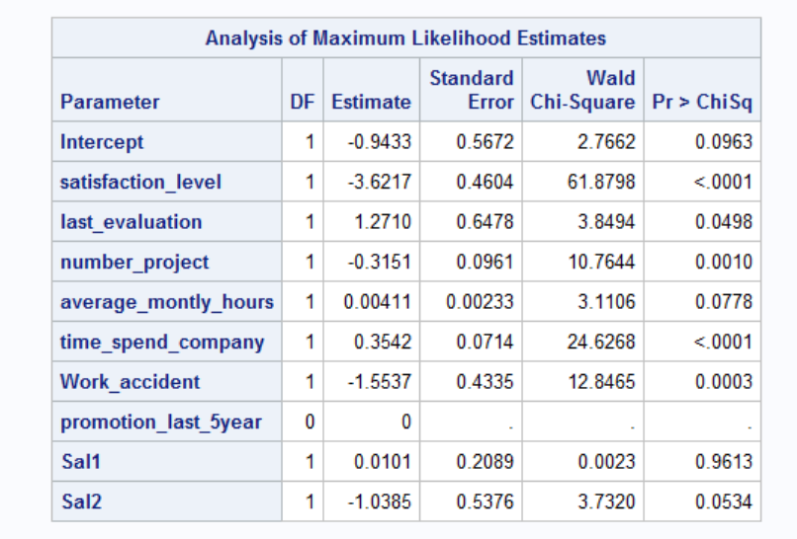
Logistic Regression by Product Manager Department
Notes:
Ishan

Slide 21
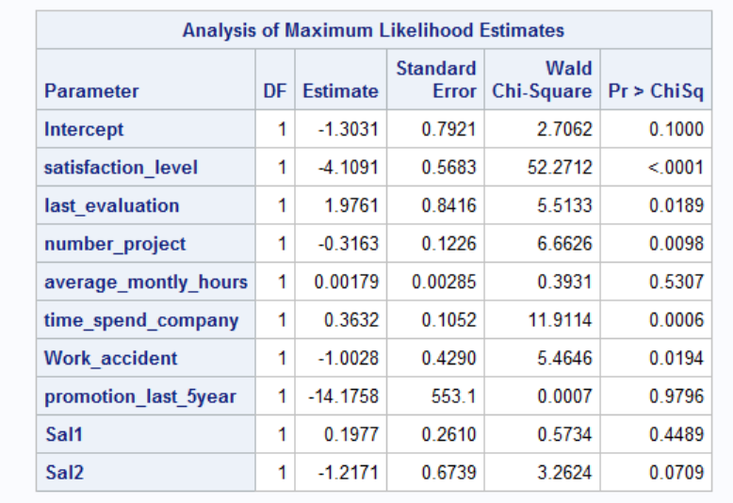
Logistic Regression by RnD Department
Notes:
Ishan

Slide 22
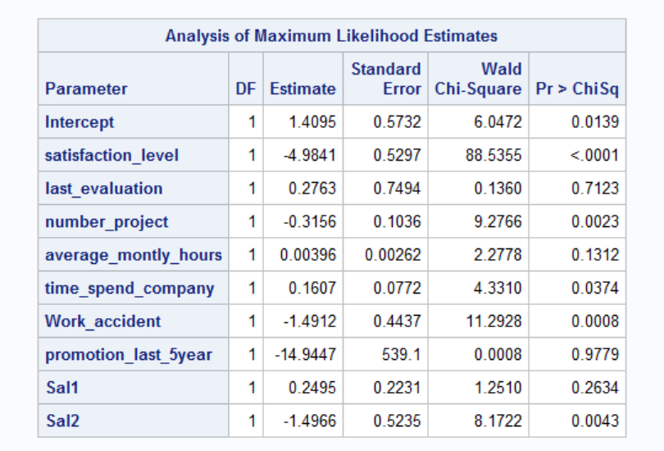
Logistic Regression by Accounts Department
Notes:
Ishan

Slide 23
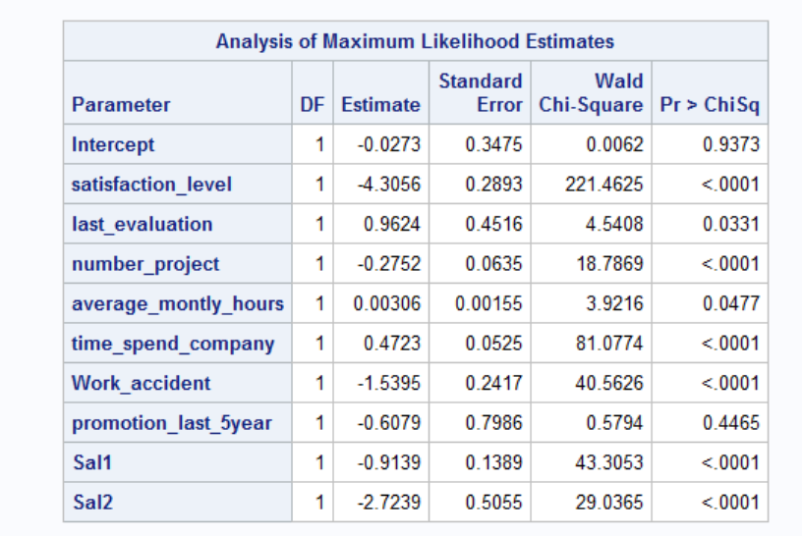
Logistic Regression by Support Department
Notes:
Ishan

Slide 24
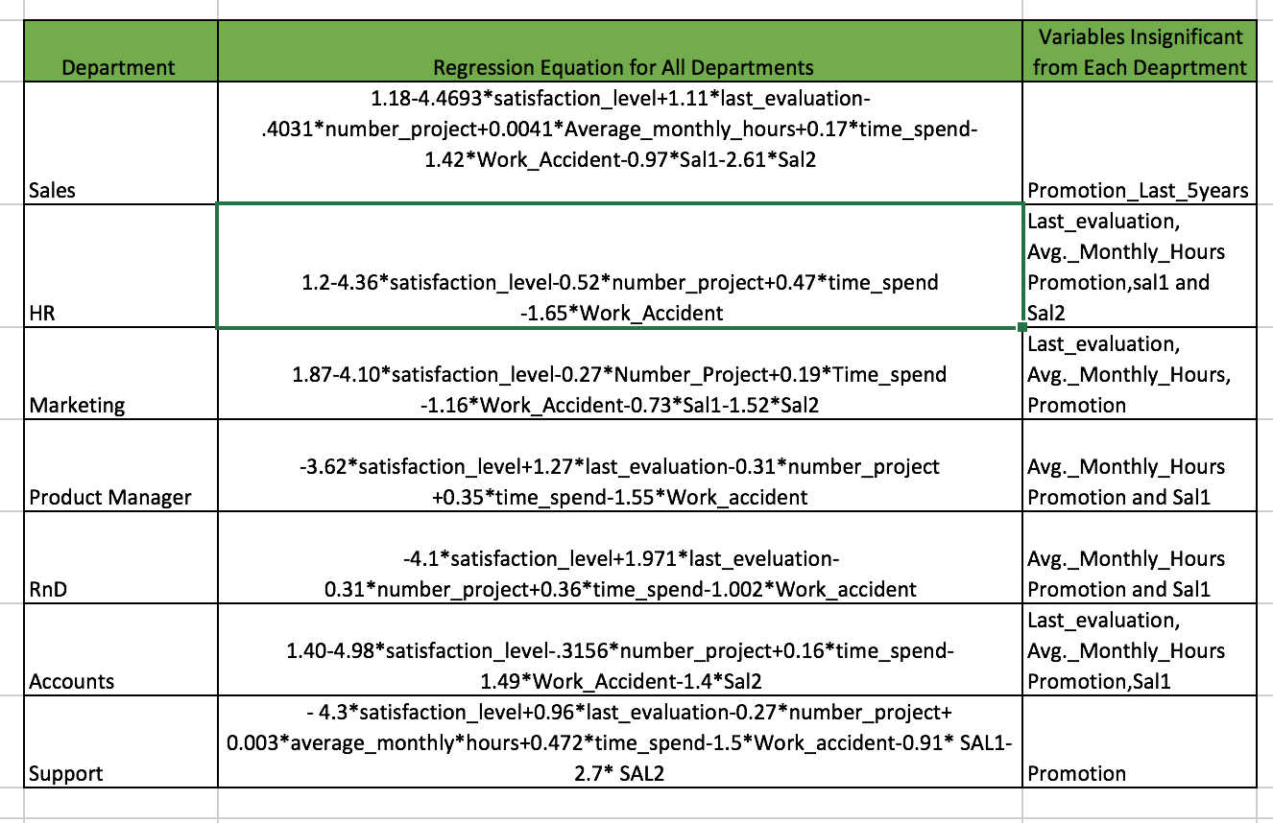
Comparison of Logistic Equation for all Departments
Notes:
Ishan

Slide 25
Conclusion
The regression equation created can predict the chance of an employee would leave the company with up to 73% accuracy.
From the regression equation for all the departments, we concluded that every department has different variables which are insignificant.
Satisfaction_Level, Time_Spent, Number_of_Projects and Work_Accident are the variables which are significant in all the departments.
To reduce the attrition rate of the company, HR should focus on the above significant variables.
Notes:
Ishan

Slide 26
Thank you!

